Slide 1
CLUB/CHAPTER HELPER APPLICATION
PREPARED BY:
RAJVARDHAN DIXIT(16BCB0109)
PRYANSH JAIN(16BCE0979)
ABHISHEK PREMAANAND(16BEE0325)
SHASANK GUPTA(16BCE0117)
UNDERTHE GUIDANCE OF:
MOHAN. K SIR

Slide 2
INTRODUCTION
ViT is a university that provids not only technical education but also helps in development of various culural skills.The clubs and chapters helps the student to develop his/her such skill.
Due to different timings of classes students are unable to give their free time in such activities thus we have decieded to build an application that could not only help in assigning tasks to members on a particular time but also hels in organizing events as well as finance manangement

Slide 3
PROBLEM STATEMENT
We are designing a program that can be used by the club member head to assign the following duties to the club members:
Desk duty
Project manager
Member Manager
Program should work in such a way that the duty hours will not clash with class timings.

Slide 4
MOTIVATION
A club head has to assign different duties to club members in there free slots, but it is very tedious process without a application because there is so many members in a club that have to do so many works.

Slide 5
SOLUTION
We are going to make a program that will take the input of free slots of the club members in a file on our drive by logged in in there account for once.
After that we can take the data from the drive to the application to run in the main application which consists of desk duty, project and member management.
The club head has to manage a executable file that has access to all the details of different members of club.

Slide 6
IMPLEMENTATION AND DESIGN
So we have completed only the information collection module of our application.
Member side application will be given to each member of the club that will generate three text files .
Name , Registration number , Cell phone number and Email ID in one text file.
Free slots on academics time table in another text file.
Class hours slots with venues in another text file.
All three text files are automatically uploaded to a Google Drive account accessible only by the club head.

Slide 7
Now the head side runs an application that :-
Creates a empty hash table with sixty keys and each key represents a slot on timetable.
Download all the text files from the drive account and are saved in a member database folder.
Our hash function will append the registration numbers of members according to the slots they are free like for example 16BCE0979 is free in L1,L3 than 16BCE0979 will be present at 1st position and 3rd position in the hash table.
Our next function will ask the user to input a slot number.
Details of all the member’s free in that will be displayed line by line.
Before closing the application, the hash table will be stored in a binary file where the list of lists object is stored in a bitwise representation. Each node represents a slot and contains the registration numbers and the free slots in open chain hashing.

Slide 8
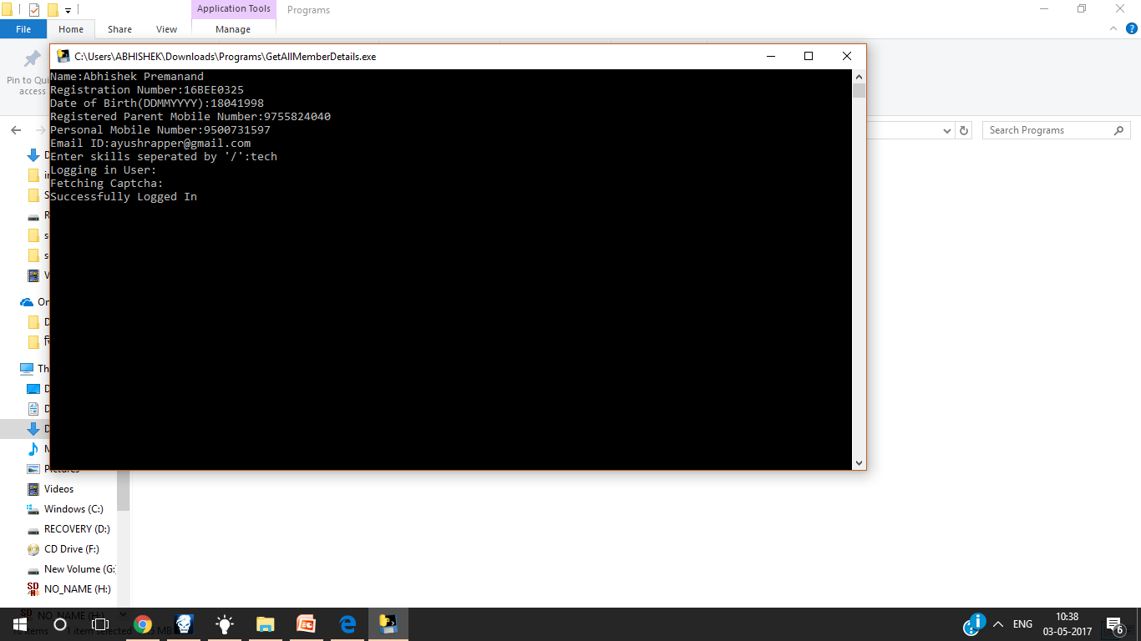

Slide 9
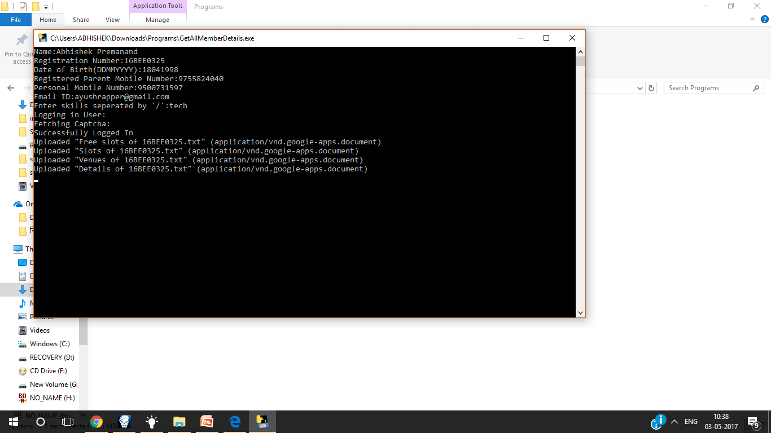

Slide 10
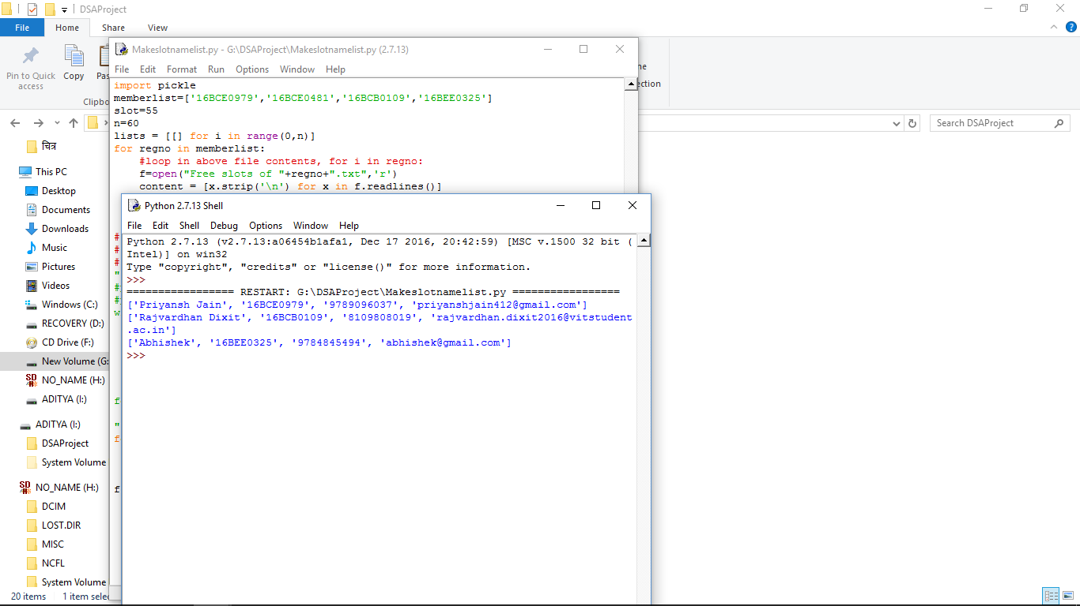

Slide 11
IMPLEMENTATION COMPONENTS
Hardware used: Computer
Software Used: Python 2.7 IDE
Third party software used: Pyinstaller to create a exe file of the source code.

Slide 12
LIST OF DATA STRUCTURES CONCEPTS USED
Hash table in Member Datatbase Module.
Graph algorithm (Dijkstra’s algorithm) in Desk Duty generator module
A Binary Search Tree in Project Manager module.

Slide 13
PROGRAM PERFORMANCE
Hash table helped us merging the data of sixty files in only one text file and reduced our search complexity to O(1).
Graph helped in deciding the priority points easily and
BST in another two modules helped in reducing the search complexity of a very huge database.

